Slide 1
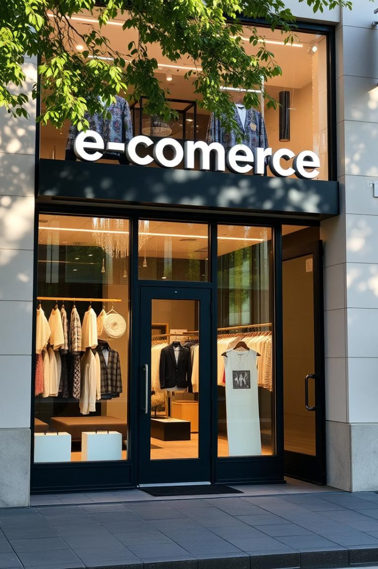
Olist Store Analysis
This presentation provides a detailed analysis of the Olist store. We focus on data visualization and insights using Excel MySQL, Power Bi and Tableau. The goal is to analyze customer, product, payment, and seller behavior.
Presenting By
SHER UZ ZAMA KHAN SURA NISHWANTH SULLA RISHWANTH JANHAVI SANJAY FARKADE CHINTHAKAYALA SAITEJA NAFIZ NAWAB SHAIKH GULIVINDALA VENKATA RAMA KRISHNA

Slide 2

Project Overview
Objective: Analyze customer, product, payment, and seller behavior to identify trends and optimize performance.
Tools Used: MS Excel, MySQL (Data Preparation), Power BI, Tableau (Data Visualization).
Data: 9 datasets from Olist E-commerce platform.
This project focuses on extracting actionable insights from the Olist e-commerce platform. By using MS Excel and MySQL for data preparation, and Power BI and Tableau for visualization, we aim to present a clear picture of the store's performance. Our goal is to provide stakeholders with the information they need to make informed decisions and drive business growth.

Slide 3

Key Performance Indicators
1
Payment Patterns
2
Customer Satisfaction
Weekday vs Weekend payment statistics.
Orders with 5-star reviews using credit cards.
3
Delivery Performance
4
Customer Behavior
Average delivery days for the Pet Shop category.
Average price and payment from São Paulo customers.

Slide 4
Weekday vs. Weekend Payment Statistics
Weekends
23% of payments.
Weekdays
77% of payments.
A pie chart analysis reveals that 77% of payments occur on weekdays. This indicates a strong correlation between payment activity and the work week.

Slide 5


Review Score 5 + Credit Card Payments
High Satisfaction
Preferred Payment
76,313 credit card transactions received a 5-star review.
Credit cards are a popular and trusted payment method.
A bar chart shows a strong positive relationship. Most credit card transactions are rated with the highest review score.

Slide 6





Average Delivery Days – Pet Shop
Order Placed
Processing
Shipping
Delivery
Pet shop products took approximately 23.5 days for delivery on average. This extended delivery time could impact customer satisfaction.

Slide 7
Average Price & Payment – São Paulo
$125.8
Avg Payment
$96.59
Avg Price
Customers from São Paulo paid an average of $125.8. The average product price was $96.59. This data reflects spending habits in this key region.

Slide 8
Shipping Days vs. Review Score
1
Fast Shipping
2
Good Experience
3
High Review
Analysis reveals higher review scores are associated with slightly lower delivery days. Efficient shipping directly influences customer perception and satisfaction.

Slide 9
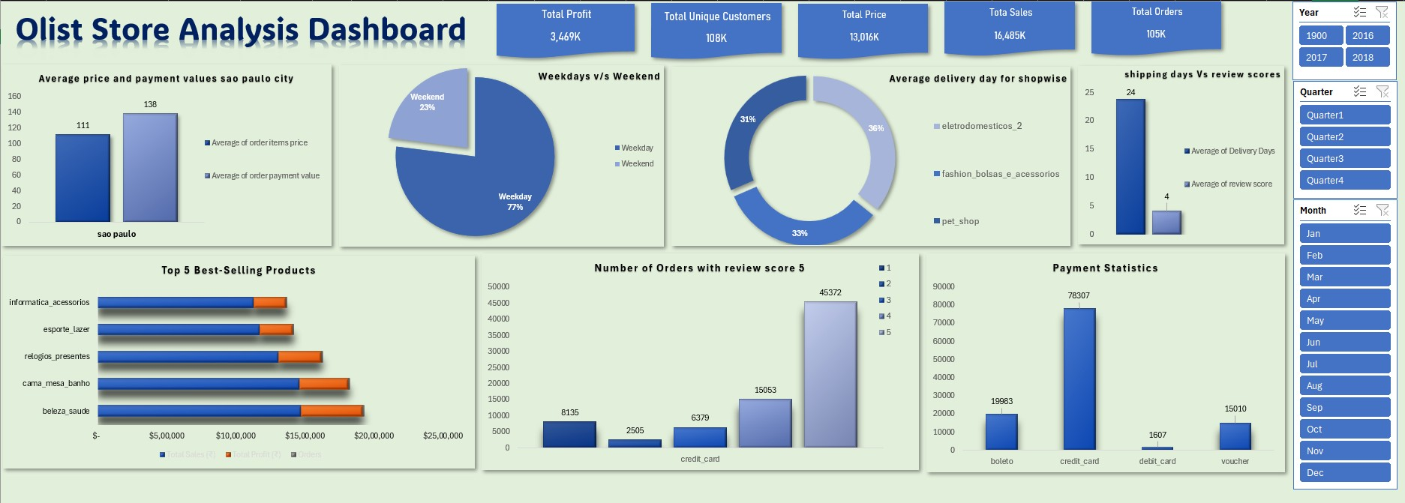
Excel Dashboard

Slide 10
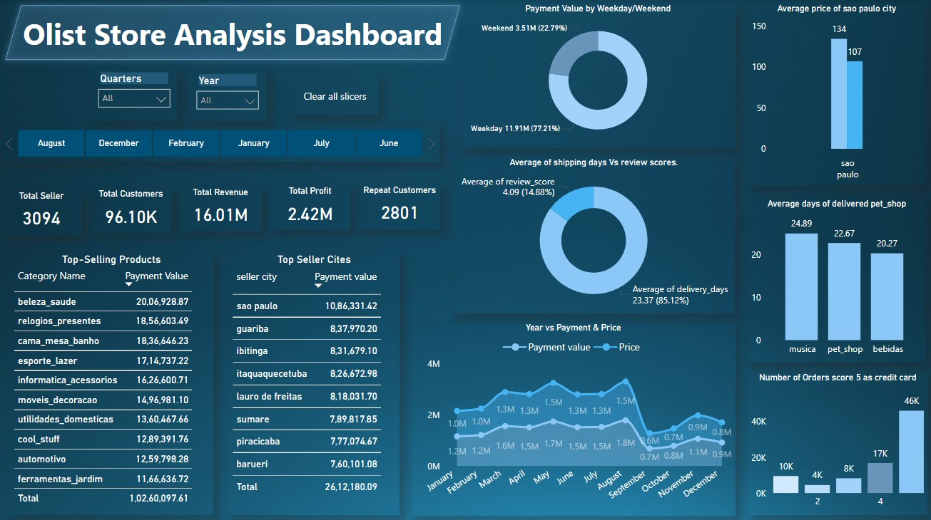
Power Bi Dashboard

Slide 11
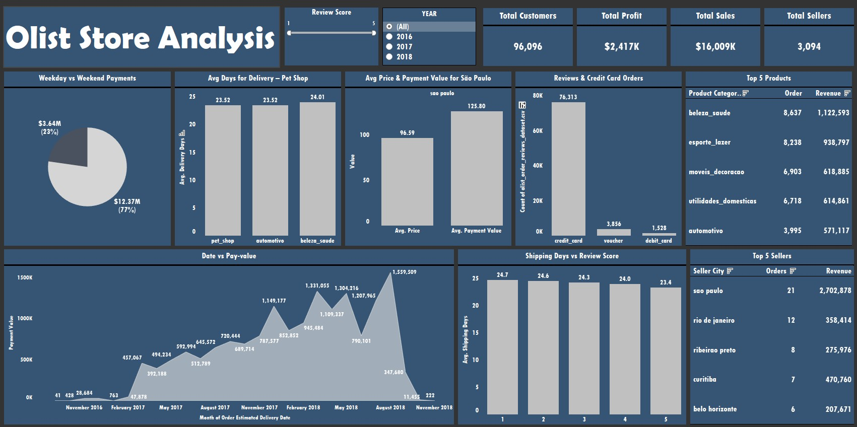
Tableau Dashboard

Slide 12
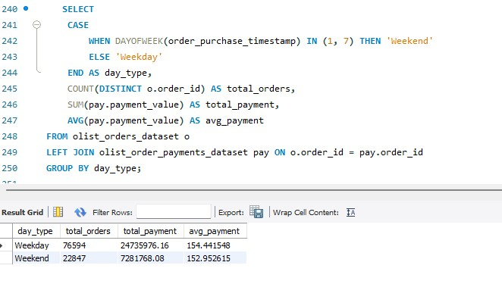
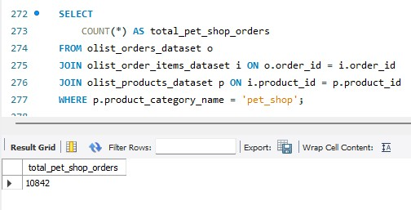
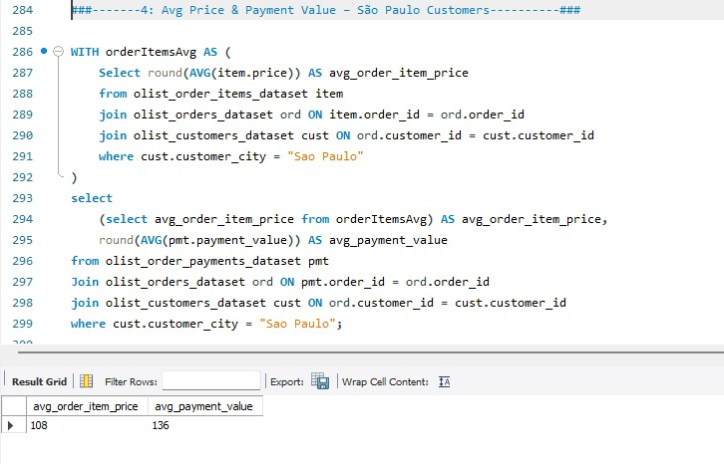
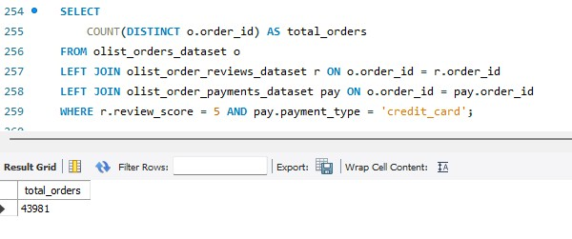
MySQL Dashboard

Slide 13
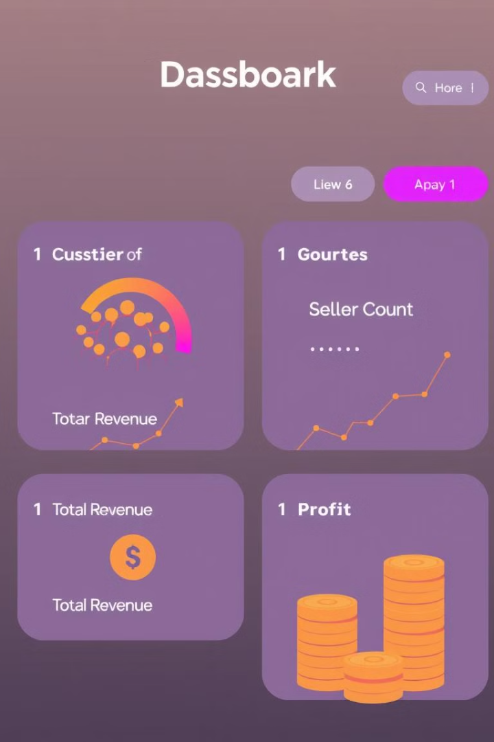
Summary & Insights
96,000+ customers, 3,000+ sellers
Total revenue: $16M | Profit: $2.4M
Most sales on weekdays; best performance in health and beauty categories
In summary, the Olist store has a substantial customer base and seller network, generating significant revenue and profit. The dominance of weekday sales and the strong performance of health and beauty products highlight key areas of strength. Moving forward, Olist can leverage these insights to optimize marketing campaigns, improve logistical efficiency, and drive sustained growth across all product categories. The insights gained from this data visualization project provide a solid foundation for data-driven decision-making at Olist.

Slide 14

THANK YOU

